Slide 1
Appendix C
Customizing AIXwindows

Slide 2
Unit Objectives
After completing this unit, you should be able to:
Explain the purpose of the AIXwindows startup files: .xinitrc, .Xdefaults, .mwmrc
Use the AIXwindows custom tool to customize a user's AIXwindow's environment
Use the xsetroot command to customize the root window

Slide 3
AIXwindows Startup Overview
$ startx
.xinitrc
(xinit)
mwm
.Xdefaults
.mwmrc

Slide 4
.xinitrc
#***********************************************************
# start xclock then sleep 1 to make sure it can get started.
#***********************************************************
xclock -geometry -0+0 -fg AntiqueWhite1 -bg grey60 -update 1 &
sleep 1
...
#**********************************************************
#
# Start the X clients. Change the following lines to
# whatever command(s) you desire!
# The default clients are an analog clock (xclock), a
# terminal emulator (aixterm), and the Motif window
# manager (mwm).
#
#**********************************************************
xsetroot -solid grey60
aixterm -geometry 80x25+0-0 &
exec mwm
xclock
Background color
aixterm
Motif Window Manager

Slide 5
Geometry Specifications for Clients
+0+0
-0+0
App A
$
$
+0-0
-0-0

Slide 6
The Color Database
The file /usr/lib/X11/rgb.txt contains a list of valid colors:
  112 219 147 aquamarine
  50 204 153 medium aquamarine
  50 204 153 MediumAquamarine
  0 0 0 black
  0 0 255 blue
  95 159 159 cadet blue
  95 159 159 CadetBlue
The X Server loads this color database by default
To view and select valid colors use the command:
$ custom -e color

Slide 7
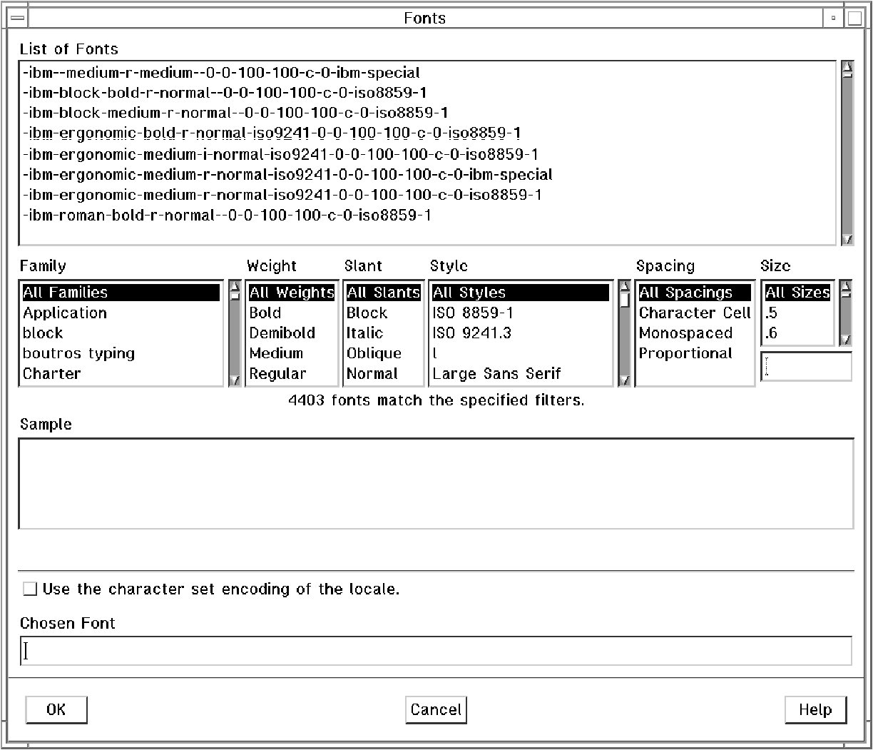
Fonts
Fonts are stored in the directory /usr/lib/X11/fonts
To list all the fonts available use the command:
$ custom -e font

Slide 8
.Xdefaults
Use .Xdefaults to customize your AIXwindows.
$ vi $HOME/.Xdefaults
  Aixterm*background: grey
  Aixterm*foreground: navy
  Aixterm*font: rom10
  xclock*update: 1
  Mwm*keyboardFocusPolicy: explicit

Slide 9
.mwmrc
$ cp /usr/lpp/X11/defaults/Motif1.2/system.mwmrc $HOME/.mwmrc
$ vi $HOME/.mwmrc
  Menu DefaultRootMenu
  {
    " Root Menu " f.title
    no-label f.separator
    " New Window " f.exec "aixterm"
    " My Window " f.exec "aixterm -bg white -fg navy"
    " Clients " f.menu "clients"
    " Custom " f.exec "custom"
    no-label f.separator
    " Refresh " f.refresh
    " Pack Icons " f.pack_icons
    no-label f.separator
    " Restart ... " f.restart
    " Quit ... " f.quit_mwm
    no-label f.separator
    " End Session " f.menu "end_session"
  }
  ~
  ~
  :wq
Do not directly edit the system-wide system.mwmrc!

Slide 10

Exercise: Customizing AIXwindows (1)

Slide 11
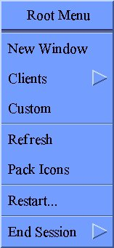
AIXwindows Custom Application
IBM

Slide 12
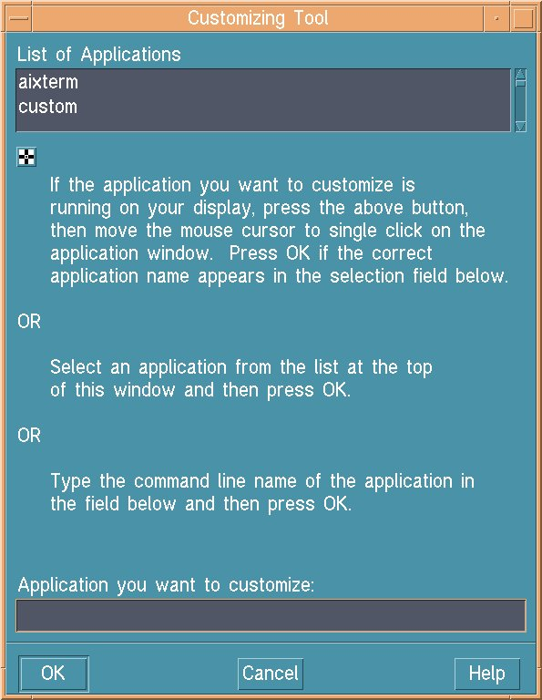
The Custom Window

Slide 13
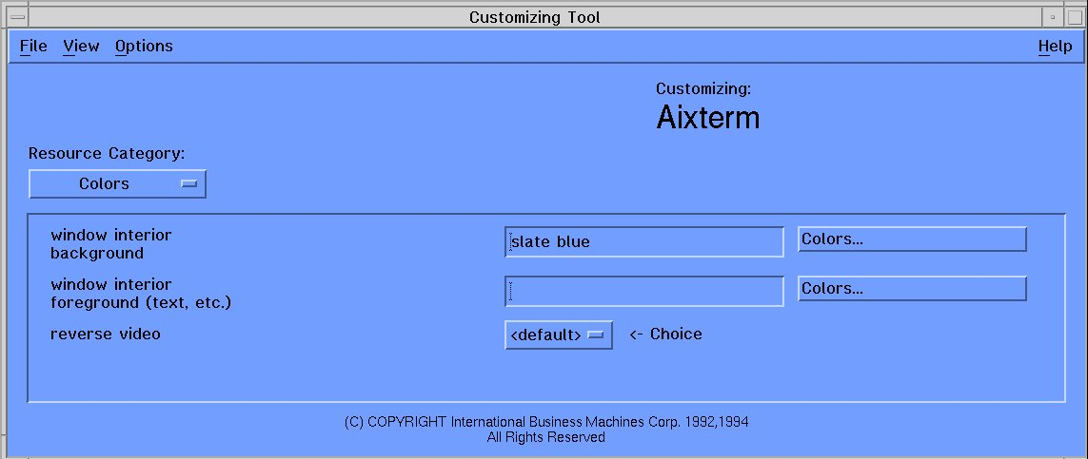
Customizing an aixterm

Slide 14
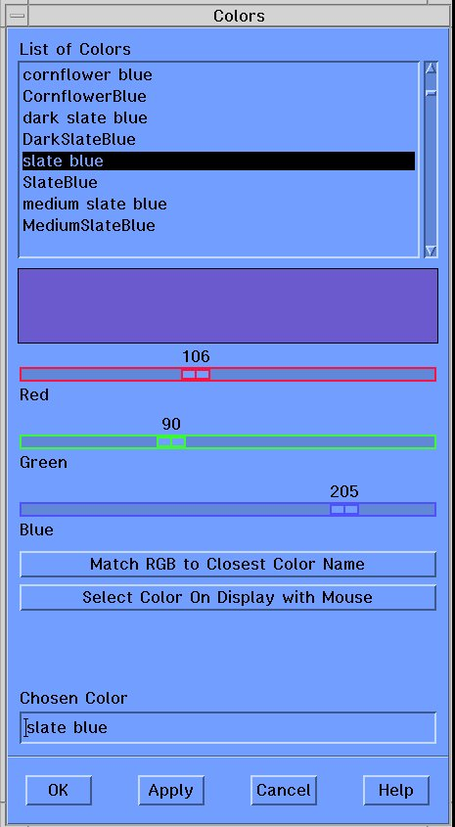
The AIXwindows Color Browser

Slide 15
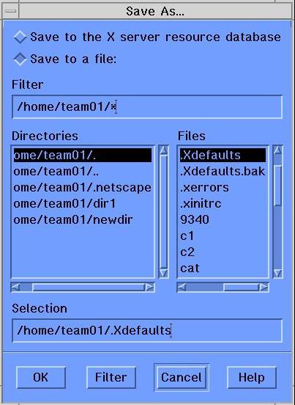
Saving the Customized Changes

Slide 16
The xsetroot Command
Customize the root window using the xsetroot command.
$ xsetroot -solid black
$ xsetroot -cursor_name gumby
$ xsetroot -bitmap /usr/include/X11/bitmaps/xsnow
Permanently customize the root window in .xinitrc.

Slide 17
Checkpoint
Match the AIXwindows startup file with its function:
  .xinitrc ___ Sets default characteristics for
  AIXwindows resources
  .Xdefaults ___ Starts the Motif window manager
  .mwmrc ___ Defines the function of the root
  menu and the window menu
Name two ways the .Xdefaults file can be customized.
True or false? The AIXwindows custom tool saves all customization choices in the .xinitrc file.
What command is used to change the appearance of the root window?
Where would the xsetroot command be placed to make a permanent change to the root window?

Slide 18
Checkpoint Solutions
Match the AIXwindows startup file with its function:
  .xinitrc _b_ Sets default characteristics for
  AIXwindows resources
  .Xdefaults _a_ Starts the Motif window manager
  .mwmrc _c_ Defines the function of the root
  menu and the window menu
Name two ways the .Xdefaults file can be customized. Edit manually, use the AIXwindows custom tool.
True or false? The AIXwindows custom tool saves all customization choices in the .xinitrc file. FALSE, most changes are stored in the .Xdefaults file.
What command is used to change the appearance of the root window? The xsetroot command.
Where would the xsetroot command be placed to make a permanent change to the root window? In .xinitrc.

Slide 19
Exercise: Customizing AIXwindows (2)

Slide 20
Unit Summary
The .xinitrc file controls which windows to start during AIXwindows startup. This file starts mwm last.
The .Xdefault file customizes various AIXwindows resources used by a user.
The .mwmrc file customizes the root menu, the window menu, and the behavior of the mouse.
Use the AIXwindows “custom” tool to customize the windows environment.
The xsetroot command will customize the root window.

